Slide 1
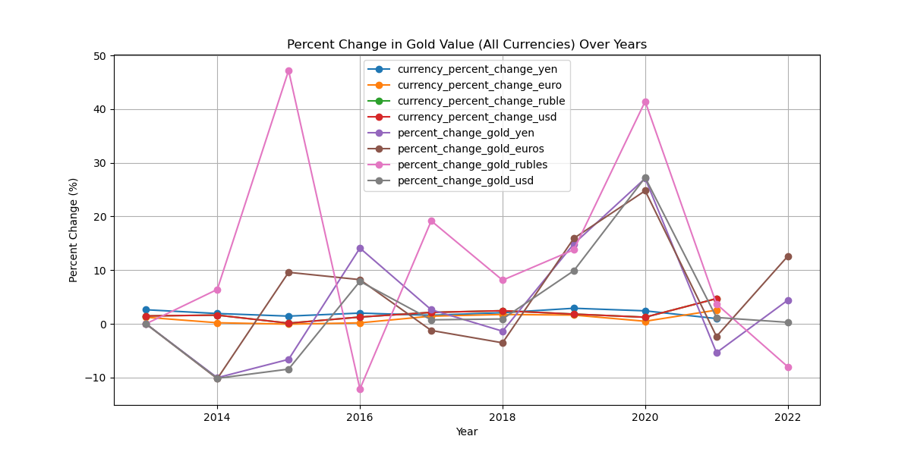
All currency inflation plotting based on percentages
Combined plotting in percentages of inflation

Slide 2
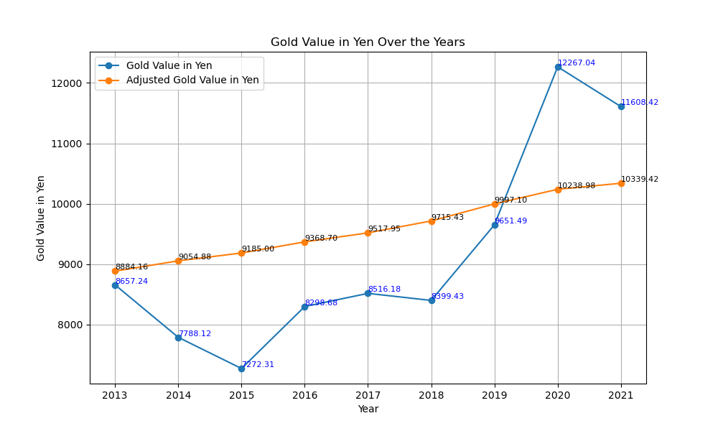
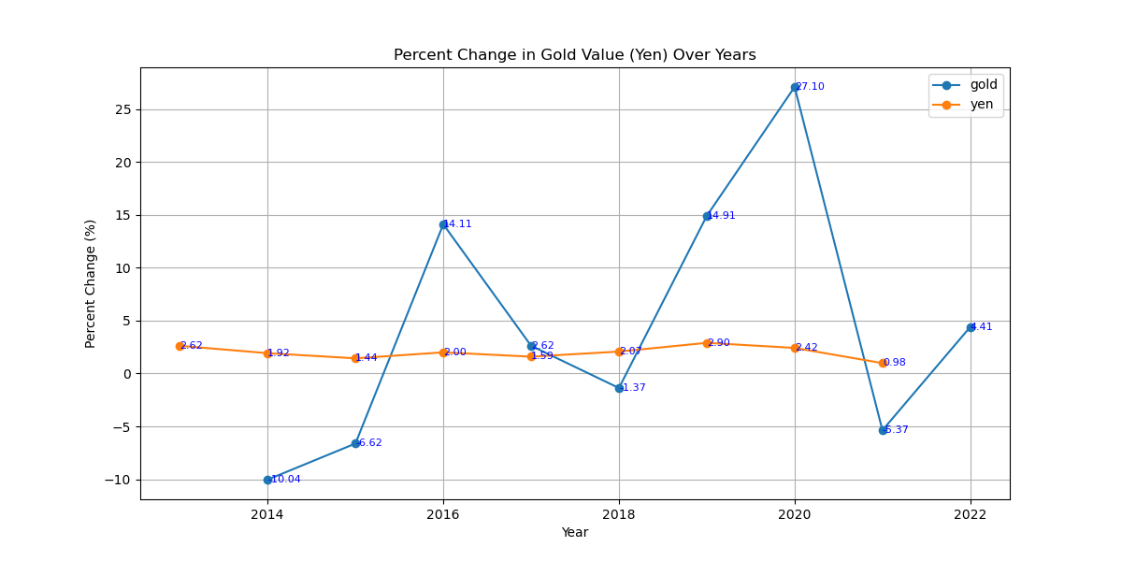
CHINESE YEN
CURRENCY specific plot
In the Gold Value In Yen Over the Years, the Adjusted Gold Value in Yen (the orange line) increases slowly in steps from $8,864.16 to $10,339.42. The orange line is a stable increase.
Whereas The Gold Value in Yen (the blue line) has an unstable change.
In the Percent Change in Gold Value (Yen) Over Years, the gold value (blue line) is stable. Whereas the Yen value (orange line) has an unstable change.

Slide 3
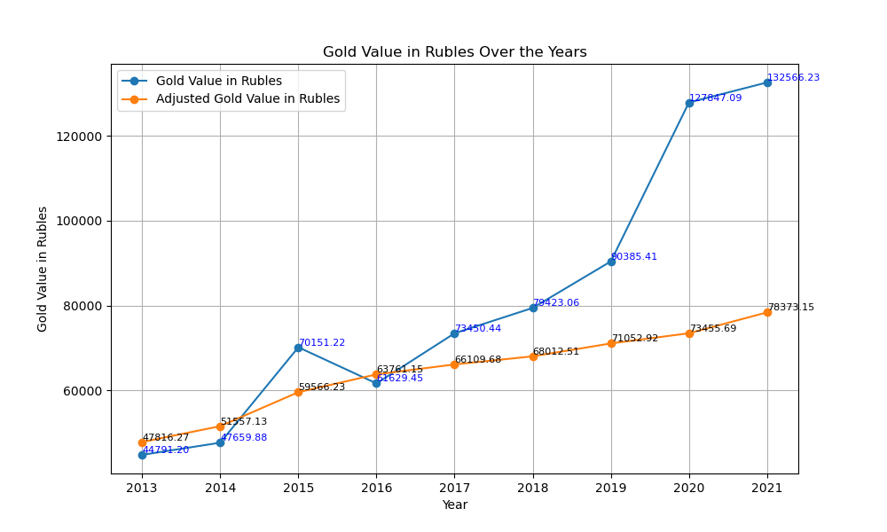
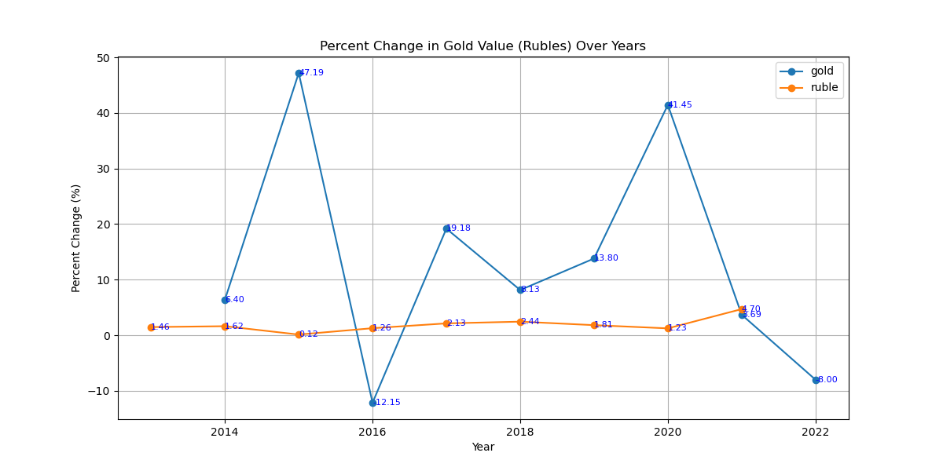
Russian ruble
CURRENCY specific plot
In the Gold Value in Rubles Over the Years graph, the gold value in rubles (blue line) increases from $44,792.20 to $132,566.23, it has an unstable change. Whereas the adjusted gold value in rubles (orange line) increases from $47,816.27 to $78,373.15.
In the Percent Change in Gold Value (Rubles) Over Years, the ruble value (orange line) is stable. The gold value (blue line) has an unstable change it ranges from 6.40% to -8.00%.

Slide 4
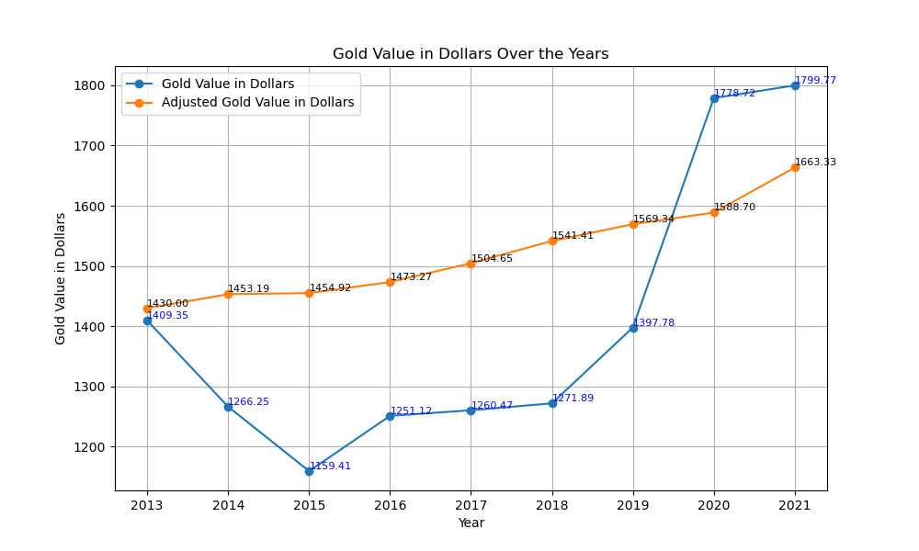
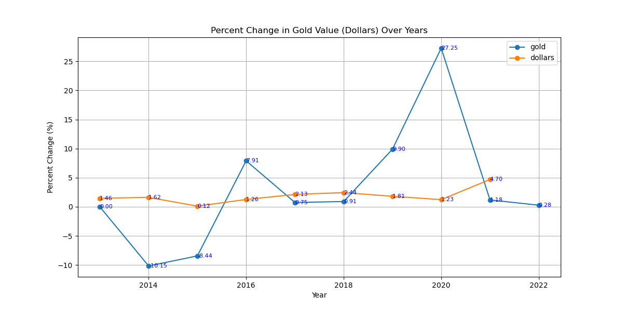
US Dollars
CURRENCY specific plot
In the Gold Value in Dollars Over the Years, the gold value in dollars (blue line) has an unstable change, it ranges from $409.35 to $1,799.77. Whereas, the Adjusted Gold Value in Dollars (orange line) has a stable increase.
In the Percent Change in Gold Value (Dollars) Over Years Graph, the gold value (blue line) has an unstable change. Whereas the inflation (orange line) changes from 1.46% to 4.70%.

Slide 5
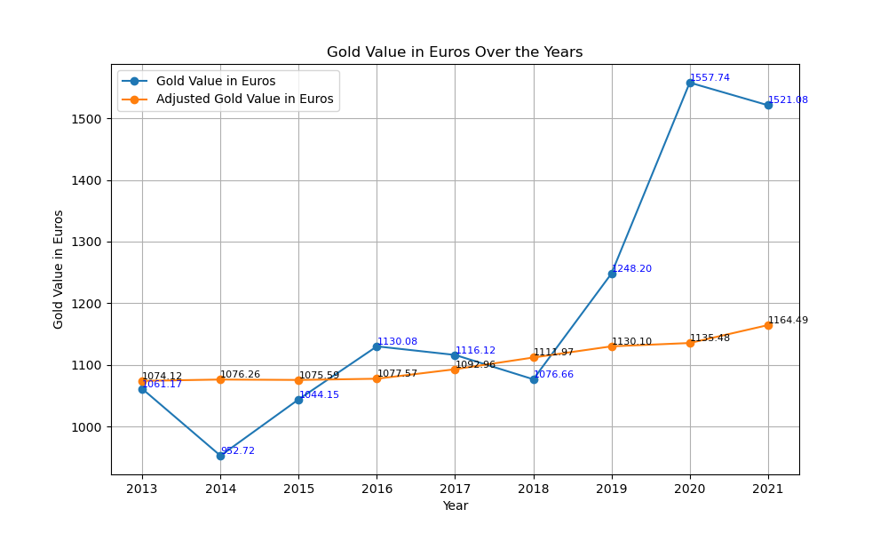
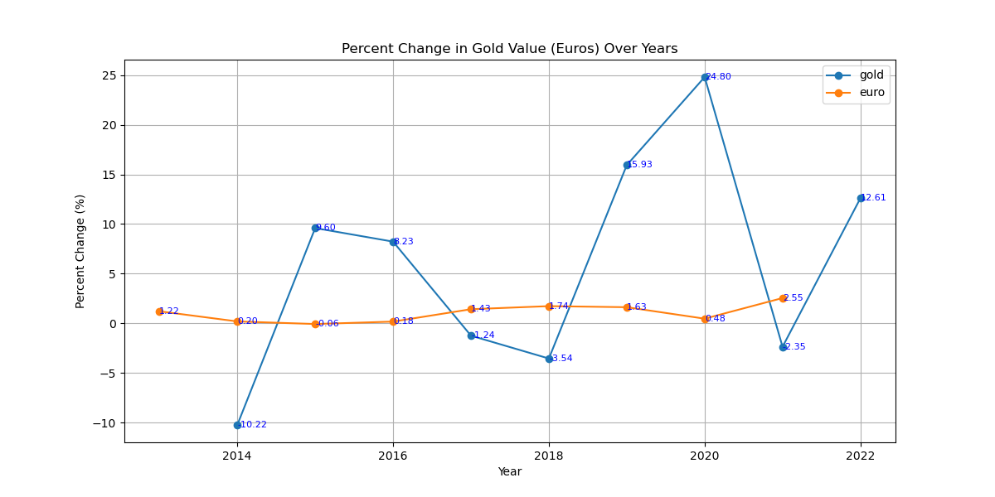
Europe EURO
CURRENCY specific plot
In the Gold Value in Euros Over the Years Graph, the Gold Value in Euros (blue line) has an unstable change. Whereas the Adjusted Gold Value in Errors (orange line) increases from $1074.12 to $1164.49.
In the Percent Change in Gold Value (Euros) Over Years, the gold value (blue line) has an unstable change. Whereas the euro value (orange line) increases from 1.22% to 2.55%.

